Slide 1

Meraki Port Shutdown Scheduler
GVE DevNet
Global Sales Segment : Global Service Provider/ Global Enterprise/Global Public Sector/Global Commercial and Small
Industries : Cities and Communities/Education/Financial Services/Government/Health Care/Manufacturing/Oil and Gas/Retail/Transportation/Utilities
LoB : Operations Automation
Architectural Plays : Enterprise
Sales Plays : Modernize the Workforce Experience for Enterprise/Other
Stien Vanderhallen
Technical Solutions Specialist
July 2022
Notes:
Notes: If your use case applies to morer than one or even all industries please keep all the industries and BOLD the industry where the PoV fits.
Smart City/Health Care/Industry and Manufacturing/Hospitality/Education/Retail/Utilities/Logistics/Professional Services/Public Sector/Service Provider
For LoB applies the same : if there is just one LoB, delete others, and bold the LoB that PoV is about.
LoB ; Safe and Security/Operations Automation/Human Resources/Operation Analytics
Please only keep the Architectural Plays that PoV is about.
Architectural Play : Enterprise / Data Center / Security / Collaboration / Service Provider

Slide 2
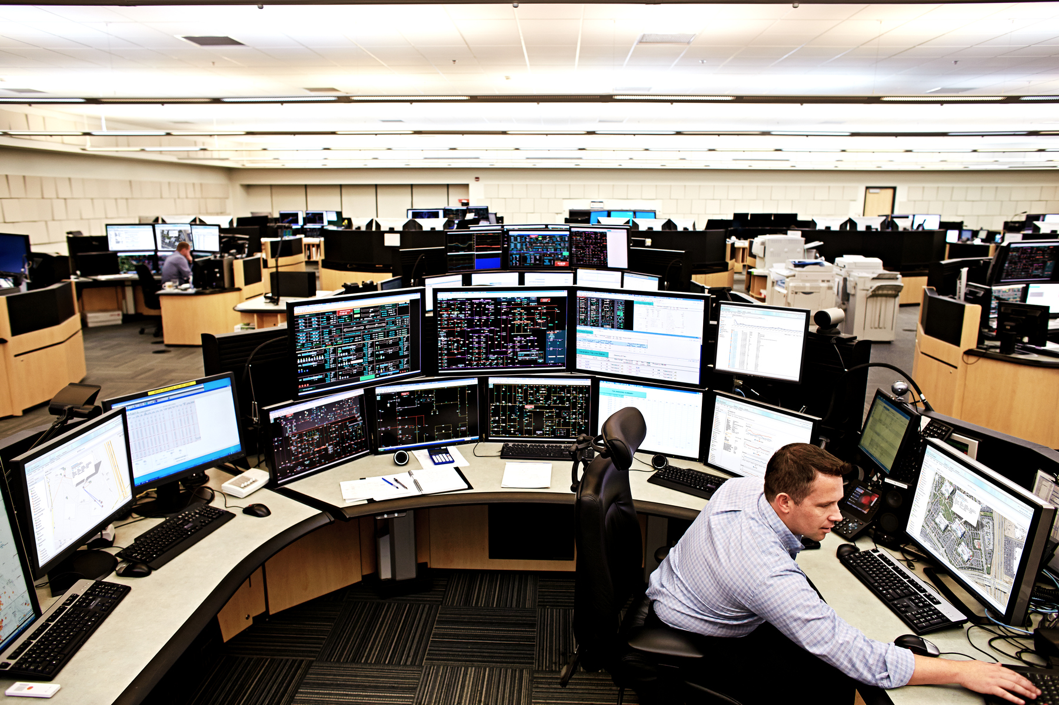
Enterprise
Operations Automation
Notes:
Please under Industry Alignment just types the Industry that PoV was created as well LoB
For the pictures, when you go to the bx.cisco.com link and select brand categories and the select photograpy you can use the engine text box to look for industry pictures and download it

Slide 3

Meraki Port Shutdown Scheduler
Business Needs/Challenges
Need: Each evening, the customer wants to shut down their switchports at a certain time.
Challenge: The Meraki dashboard does not currently allow for scheduling ports to shut down each evening. Therefore, the customer now has to do this manually, on a port-by-port basis.
Solution
This prototype allows for the use to first schedule when to shut down their switchports, and then interacts with the Meraki cloud to actually shut down those ports when necessary.
Business Outcomes
The customer now does not have to manually shut down their switchports each evening. They will now stick with the Meraki stack and use this solution until a corresponding feature is added to the Meraki dashboard natively.
Notes:
Notes :
At the top Select a short name of the PoV naming product or products involved
Insert the logo f the customer when applies (if it is a general use case ignore the insert logo)
For Business Needs/Challenges :
For bullet Need : Write a small sentence that in an objective way to express the problem to solve when you refer to this problem, avoid to use technical words, uses business language as C-Level
For bullet Challenge : Write the main challenge and drawback the customer has to solve the problem (also avoid technical words, make a message in C-Level)
Solution :
Describe in a small sentence what is the solution about to deal with the problem referred, again, please avoid to uses technical words and use C-Level language
Business Outcomes:
Use small paragraph to show the benefits and gains with the solution explained above, please avoide to uses technical words and use C-Level language

Slide 4
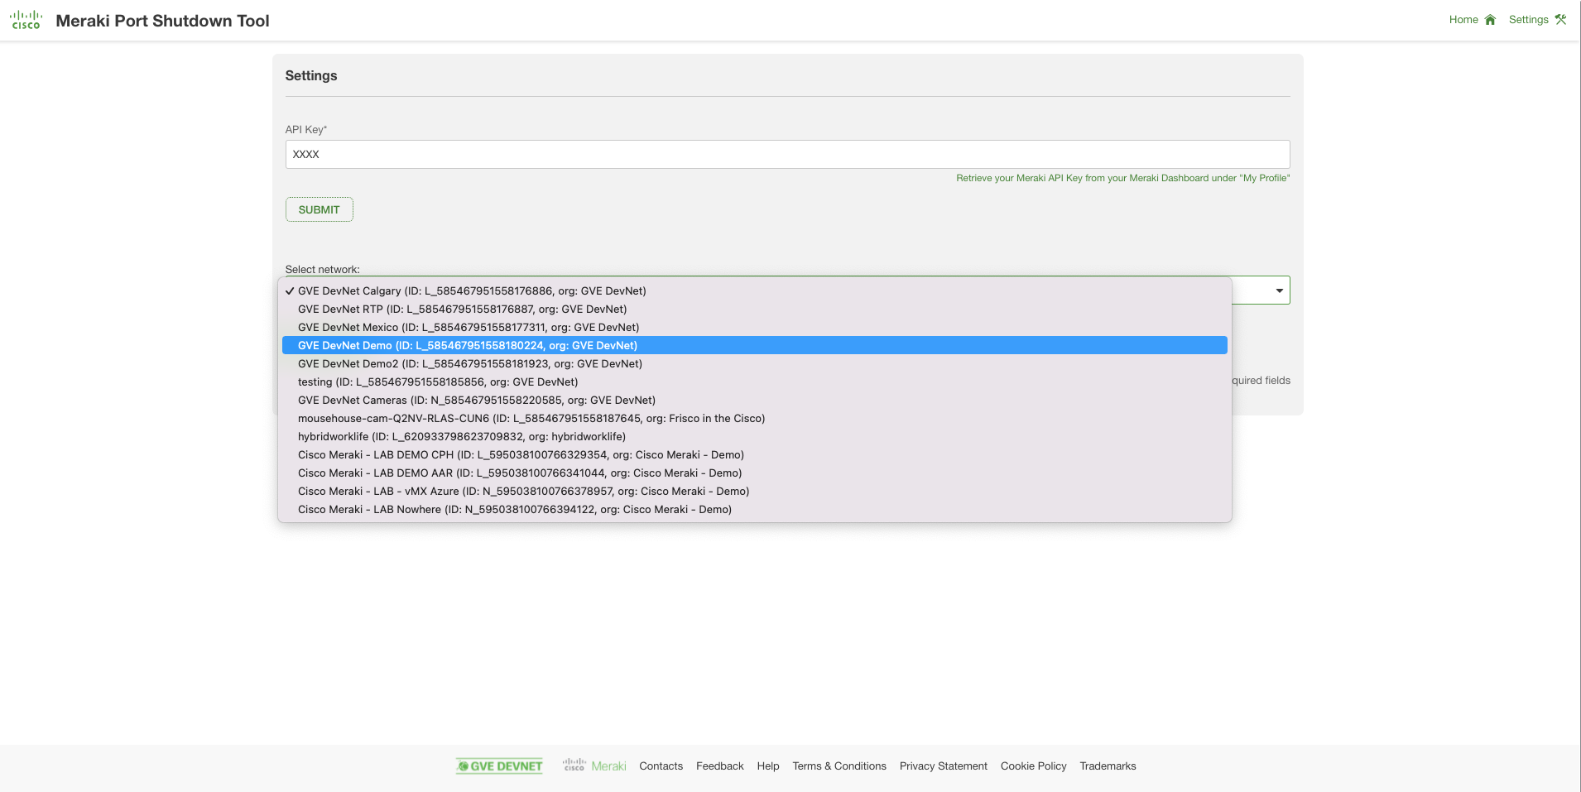
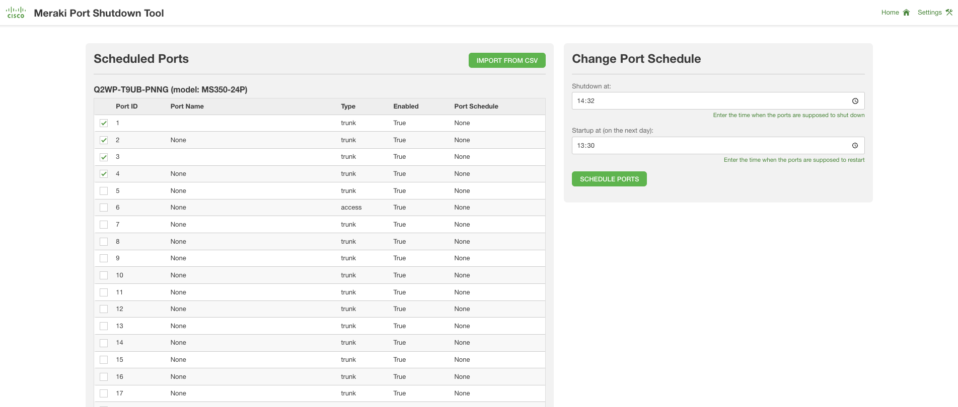
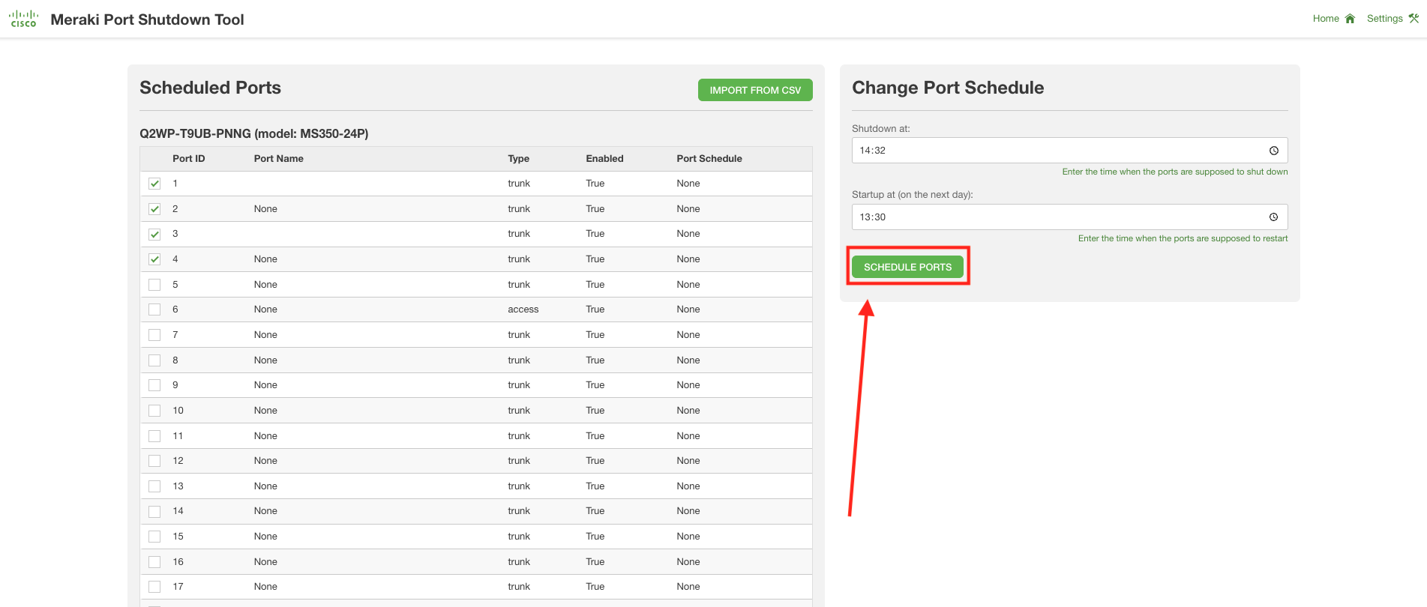

Meraki Port Shutdown Scheduler
Select Meraki organization and network
Select and schedule switch ports
Confirm selections and schedule
The user selects the Meraki organization, and Meraki network within, for which they want to set up and enforce a port shutdown schedule.
The user selects which ports, from which switches, will have to adhere to their port shutdown schedule, as well as a start- and end time to port shutdown.
The user confirms their selection, which enforces the port shutdown schedule via the Meraki cloud.
Notes:
Notes :
Use this slide to explain the story around your solution. It is a prototype in high level point of view. Think about a explanation of your solution to an executive that does not know Cisco and deep dive technology
This slide it is also to share knowledge with a non-technical guy (like BDM or sales or C-Level) what is the solution about and how will work . You can do as many steps as you need to describe the main flow of the solution
LINK for Icons https://www.flaticon.com/

Slide 5
Meraki Port Shutdown Scheduler
Customer / Opportunity
The customer has a considerable Meraki install base for their LAN.
What is the story? What was the business challenge?
Each evening, the customer wants to shut down their switch ports at a certain time. This functionality is currently not available in the Meraki dashboard. That means they currently shut down and start up their switch ports manually, which is a tedious, error-prone task.
What the PoV accomplished?
This PoV offers an interface for the customer to (1) select the switch ports they want to shut down/start up and (2) define the start- and end time for switch port shutdown. The PoV interacts with the Meraki cloud to then enforce this schedule on the selected ports.
What are the benefits to the customer?
The customer now does not have to worry about manual selection of the switch ports they want to shut down, as well as timely execution of this shutdown, as well as restart of those ports.
Notes:
Notes :
*** From the side to the rest you can use all technical wording and reference from Cisco APIs, integrations and tools
Please fill the slide thinking about technical people and the scope of this PoV (what it is cover from the solution proposed and if there is a limitation or need a special integration to be awared
Align the bullet
What are the benefits to the customer?
With the Business Outcomes that you explain in the business case slide. And also you can add technical benefits on this slide or future steps to be added later as following steps

Slide 6
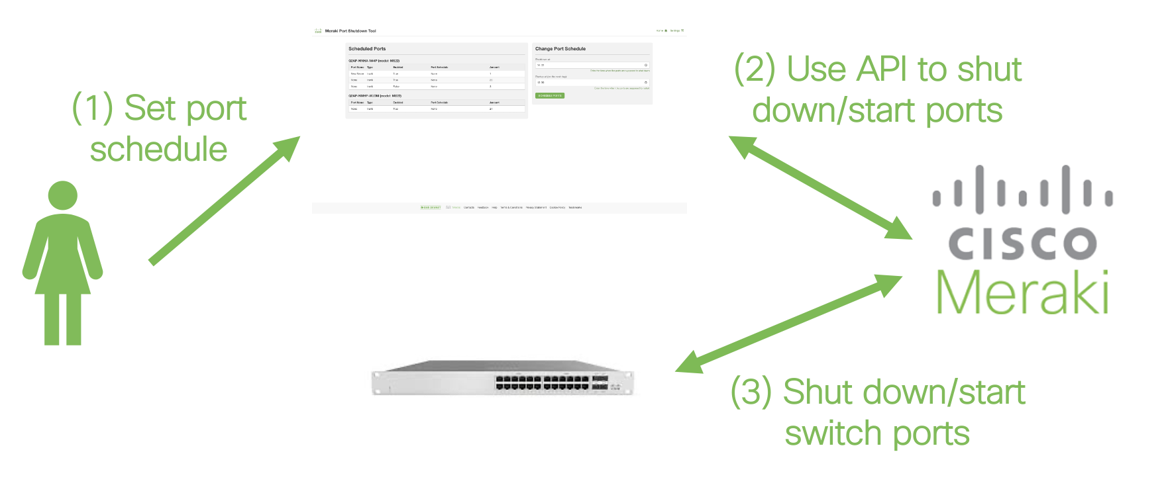
High Level Design PoV
Notes:
Notes:
Describe the High level design and flow for the PoV and mentioned the tools used
Do not forget to add the link to github repository or other specifcs needs

Slide 7
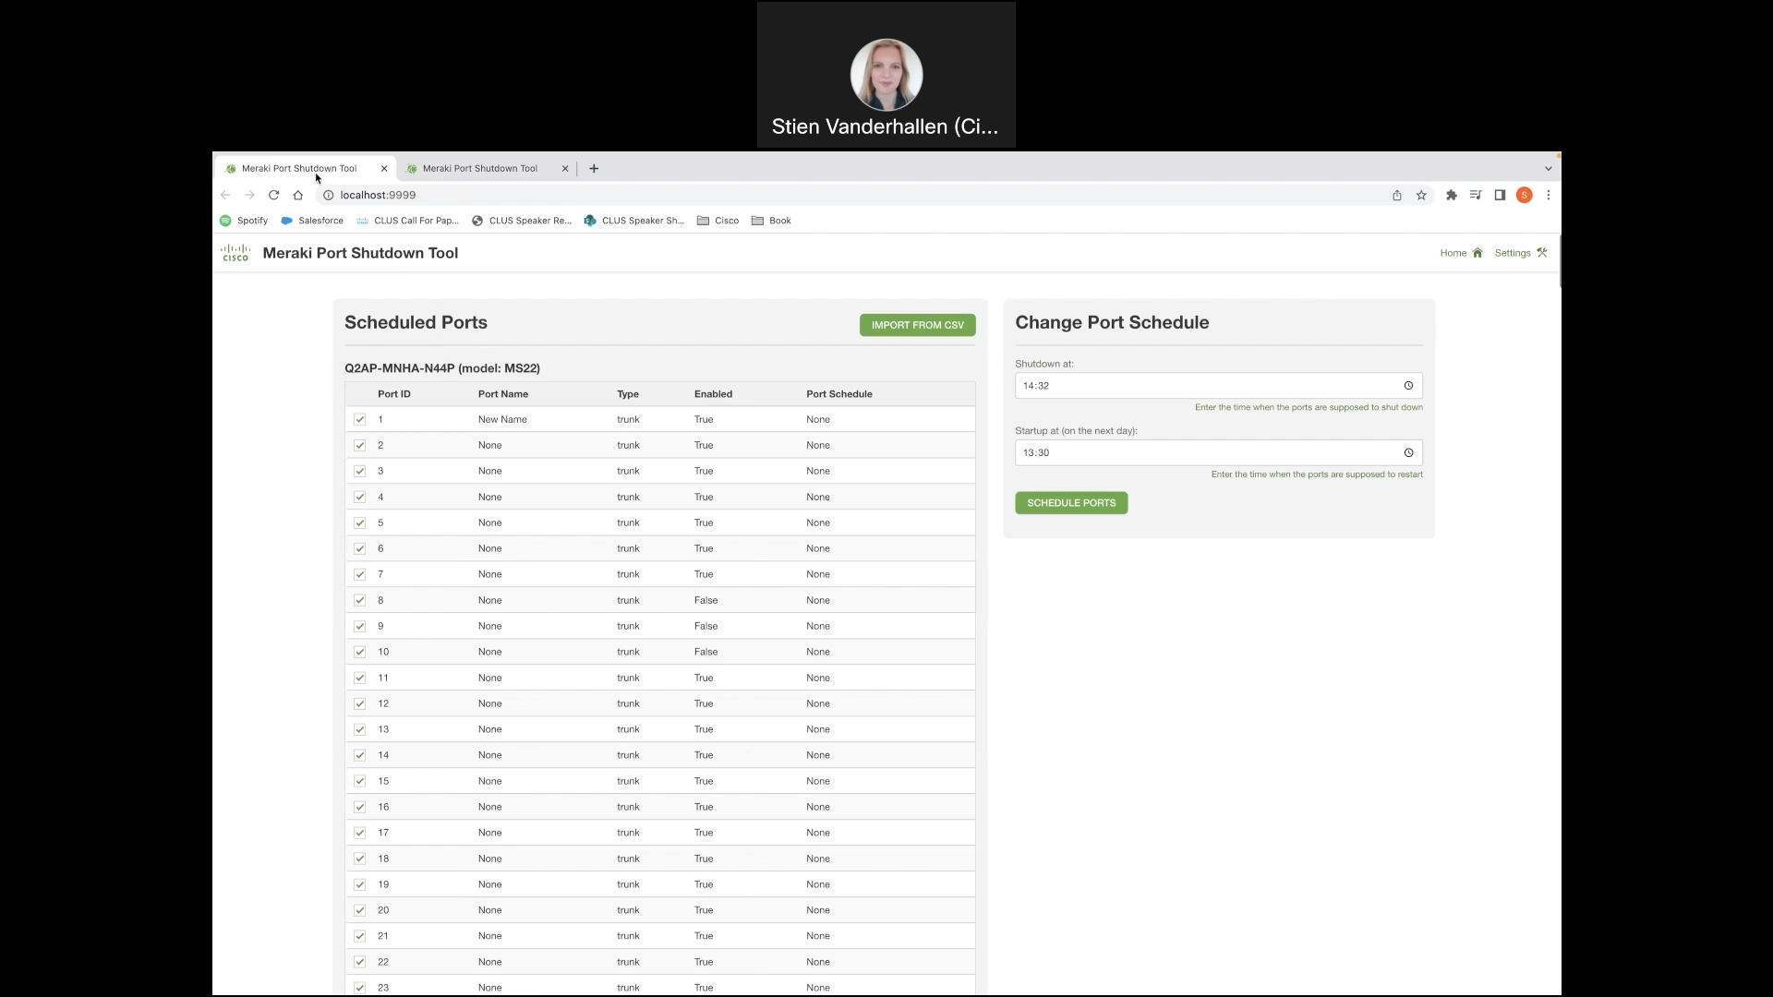
Show GUI or mockup
Notes:
Notes :
Some of the PoVs are developed either Sandboxes from dcloud, devnet or customer premises lab.
In the case the PoV is execute under Customer Premises Lab and would be hard to replicate the PoV, Please record video with the Demo and add the link to it.

Slide 8
Tools (products) Used
Python,Flask,Meraki REST API,Meraki
Notes:
Notes :
Describe all the tools,
If there is a need for a specific licenses or code versión or hardware specifications mentioned here

Slide 9
Check out the GVE Devnet team @
https://gve-devnet.cisco.com/
Open a GVE case @
https://cep.cloudapps.cisco.com/case

